Slide 1
Finite-State Morphological Parsing Techniques
DSA0307-Natural Language Processing
Presented By:
S.Muskan
Guided by:
Dr Anbazhagan K

Slide 2
Introduction
What is Morphology?
Morphology is the branch of linguistics that studies the internal structure of words.
Words are formed by combining smaller meaningful units called morphemes.
Morphological parsing identifies these morphemes and determines their grammatical roles.
It helps computers understand how words are constructed.
Morphological parsing is a fundamental preprocessing step in Natural Language Processing (NLP).
Example
Unhappiness = Un + Happy + Ness
Un → Prefix
Happy → Root word
Ness → Suffix
Notes:
Image source: https://community.arm.com

Slide 3
Finite-State Machines (FSM)
What is a Finite-State Machine?
A Finite-State Machine (FSM) is a computational model that processes input symbols by moving through a finite number of predefined states.
Components:
States – Represent different stages of processing.
Transitions – Rules that determine movement between states.
Input Symbols – Characters or morphemes being analyzed.
Start State – Initial state where processing begins.
Final State – Indicates successful recognition of a valid word.
Why FSM?
Fast execution
Simple design
Efficient for pattern matching
Widely used in lexical analysis and NLP
Notes:
Image source: https://kernelmasters.org

Slide 4
Morphological Parsing
Morphological parsing is the process of dividing a word into its meaningful components (morphemes) and identifying their grammatical functions.
Main Components:
Root/Stem – Core meaning of the word
Prefix – Added before the root
Suffix – Added after the root
Lexicon – Database containing valid root words
Morphological Rules – Define valid word formations
Example
Word Parsing
Playing Play + ing
Unhappy Un + Happy
Reusable Re + Use + able
Notes:
Image source: https://www.slidemake.com

Slide 5
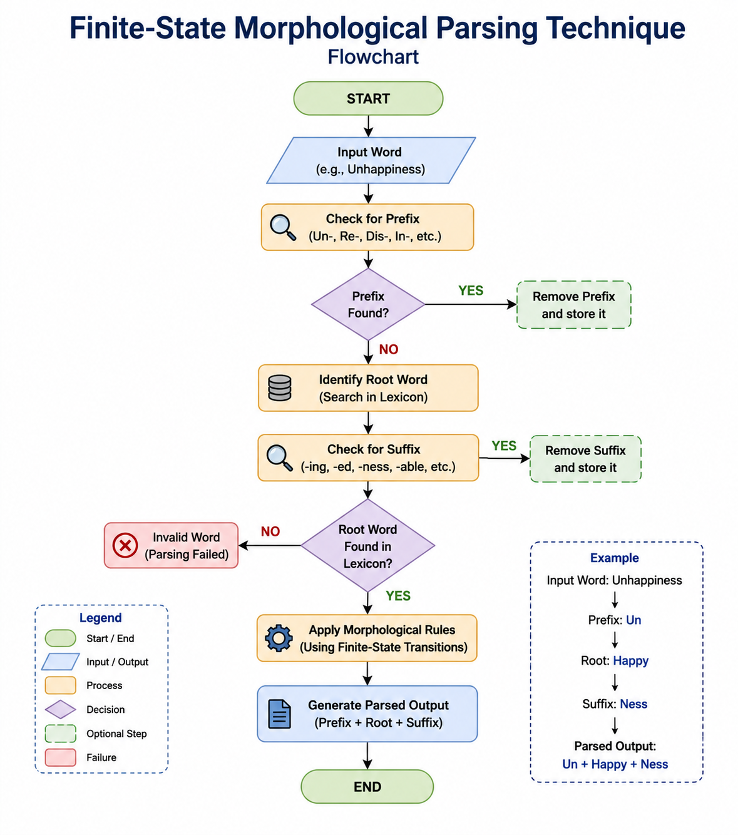
Notes:
Image source: https://community.arm.com

Slide 6
Advantages
Works very fast
Uses less memory
Easy to build and maintain
Works well for regular words
Can handle many words
Supports different languages
Analyzes words efficiently
Widely used in NLP applications
Notes:
Image source: https://static1.makeuseofimages.com

Slide 7
Limitations
Cannot understand unusual words (like go → went).
Does not understand the full meaning of a word.
Needs predefined rules to work correctly.
Has difficulty with complicated words.
Different languages need different rules.
Too many rules can make it slower.
Does not understand the sentence around the word.
Notes:
Image source: https://ee.cdnartwhere.eu

Slide 8
Applications
Natural Language Processing
Spell Checking
Grammar Checking
Machine Translation
Search Engines
Information Retrieval
Speech Recognition
Text-to-Speech Systems
Optical Character Recognition (OCR)
Chatbots and Virtual Assistants
Question Answering Systems
Real-World Examples
Google Search
Grammarly
Voice Assistants
Language Learning Applications
Notes:
Image source: https://i.pinimg.com

Slide 9
Conclusion
Morphological parsing breaks words into meaningful morphemes.
Finite-State Machines provide an efficient method for morphological analysis.
The technique is fast, reliable, and computationally efficient.
It is widely used in NLP tasks such as machine translation, spell checking, and speech processing.
Future systems combine finite-state methods with Machine Learning and Deep Learning to improve accuracy and handle complex languages.
Notes:
Image source: https://www.andersdx.com

Slide 10
THANK YOU!
Notes:
Image source: https://alcorfund.com

